Slide 1
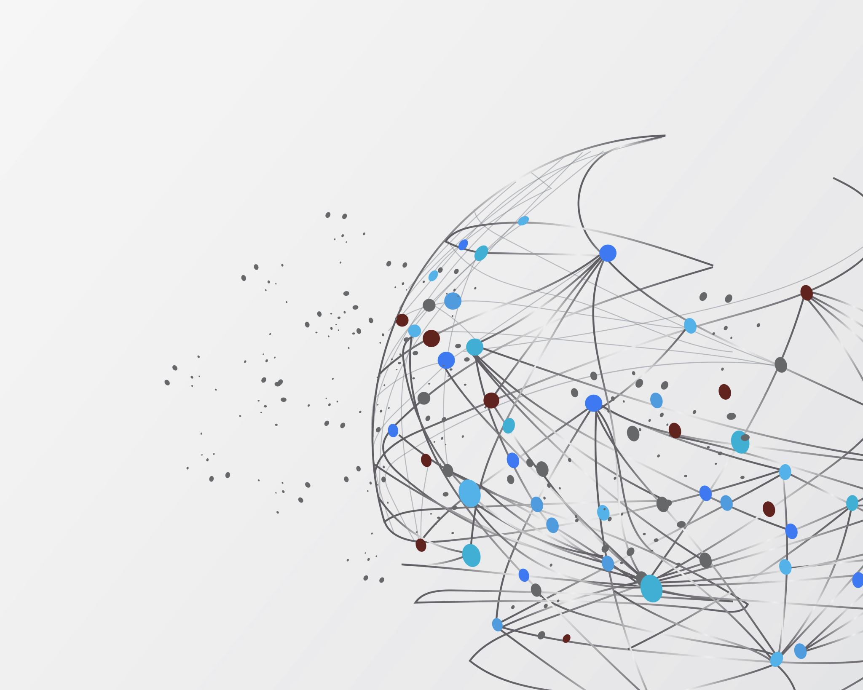
Target Prioritization for Leukemia
Group 2
Md Tajrianul Islam

Slide 2
Methodology
We will extract data for all small molecules related to Leukemia and Acute myeloid leukemia from the ChEMBL database
In general we will look for the most popular targets in our data
For our sponsor’s requirement we will be only focusing on small molecules that have data based on homo sapiens as target organism and single protein type targets

Slide 3
Methodology
Important Notes:
The mechanism of action and the molecular target of the drug are surprisingly complicated, for many drugs there are complex modes of action, or cases where the target assignment is still tentative
We will be prioritizing them based on the most popular mechanism of actions
We are also careful to only include targets that are responsible for the clinical efficacy of the drug

Slide 4
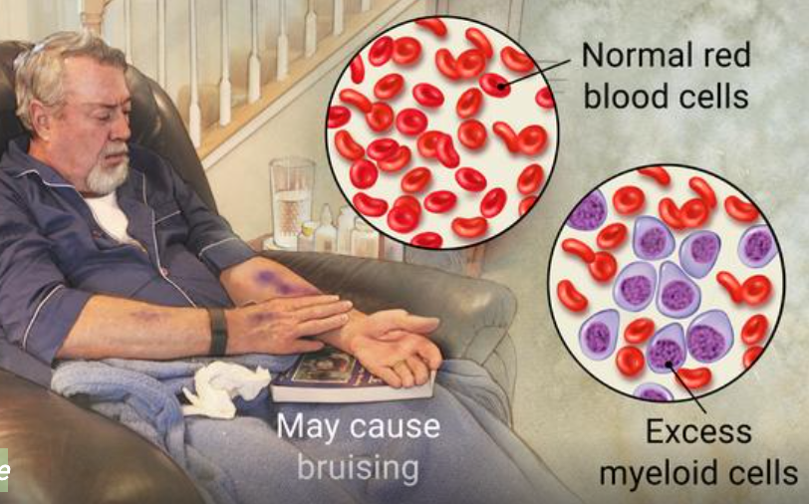
Leukemia
Leukemia is a cancer of the body's blood-forming tissues, including the bone marrow and the lymphatic system. It usually involves white blood cells.
Symptoms
Fever or chills
Persistent fatigue, weakness
Frequent or severe infections
Losing weight without trying
Swollen lymph nodes, enlarged liver or spleen
Easy bleeding or bruising
Recurrent nosebleeds
Tiny red spots in your skin (petechiae)
Excessive sweating, especially at night
Bone pain or tenderness
Notes:
Rian

Slide 5
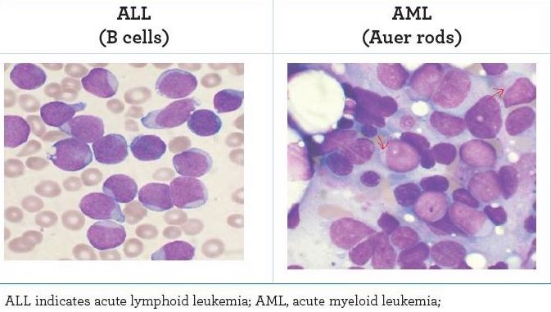
Leukemia, Myeloid, Acute
Leukemia is diagnosed 10 times more often in adults than children
60,300 people are expected to be diagnosed with leukemia this year
Over 382,000 people are living with leukemia, or are in remission
Every day 170 Americans are diagnosed with leukemia and 67 lose the fight
Notes:
Rian

Slide 6

Dataset Overview
For our analysis, we extracted the data from ChEMBL database:
Filtered the data based on "Leukemia" and "Leukemia, Myeloid, Acute" Indication.
Browsed and extracted the data on Mechanism level.
The final dataset consists of 410 rows and 25 variables or columns
The data type of all the 25 variables is "object" type except for the Max Phase which is of "integer" type.
Notes:
Kashika

Slide 7
Variable Definitions
Column Name​ | Data Type​ | Description​
CHEMBL_ID​ | VARCHAR​ | ChEMBLidentifier​
Target_Name​ | VARCHAR​ | Target Name​
Action Type​ | VARCHAR​ | Type of action of the drug​
Target Type​ | VARCHAR​ | Type of the target​
Target Organism​ | VARCHAR​ | Source organism of molecular target or tissue​
Mechanism of Action​ | VARCHAR​ | Description of the mechanism of action​
First Approval​ | VARCHAR | The FDA approval date for the product​
Max Phase​ | NUMBER​ | Maximum phase of development reached for the compound​
Parent Molecule Name​ | VARCHAR​ | Name of the Parent Molecule​
Parent Molecule Type​ | VARCHAR​ | Type of the Parent Molecule​
Notes:
Kashika

Slide 8
Target Type Distribution
It is evident from the Target Type distribution graph that "Single Protein" target has the highest distribution which is clearly our focus area.
Notes:
Kashika

Slide 9
Target Type Distribution in Homo Sapiens
In ‘Homo Sapiens’ where the parent molecule type is small molecule, we observe that the ‘Single Protein’ target type is the predominant one and it will be considered for further analysis.
Notes:
Kashika

Slide 10
Target Type Distribution by Maximum Phase of development
From the chart we infer that the target type ‘Single Protein’ is the one which has highest targets in Phase 3 & Phase 4 for target organism Homo Sapiens.
Notes:
Alok

Slide 11
Target Type Distribution by Maximum Phase of development and unique ChEMBL IDs
The Target Type ‘Single Protein’ has the highest targets in phase 4 when distinct ChEMBL IDs are considered.
Notes:
Alok

Slide 12
Maximum Phase of Indication by Action Type in Single Protein Targets
‘Inhibitor’ action type has the highest number of targets in maximum phase 4 of developing a compound in Single Protein Targets as well.
Notes:
Alok

Slide 13
Target Distribution by top ten highest Parent Molecules
This chart represents the top ten highest Parent Molecules targets by small molecules and single protein targets.
Notes:
Spurthi

Slide 14
Maximum Phase of Indication of Targets by Parent Molecules
This chart represents the maximum phase of top ten parent molecules with ‘REGORAFENIB’ having the highest targets in maximum phase of indication 4.
Notes:
Spurthi

Slide 15
Target Distribution by top ten highest Mechanism of Action
This chart represents the top ten highest mechanism of action in small molecules and single protein target type.
Notes:
Spurthi

Slide 16
Target Distribution by top ten highest Mechanism of Action by Target Names
This chart represents the highest mechanism of action in small molecules and single protein target type along with Target Names
Notes:
Sweta

Slide 17
Targets by top ten Mechanism of Action and Maximum Phase of Indication
This chart represents the top ten targets chosen by single protein target type, small molecules and highest mechanism of action. It also displays the phase of indication of the top ten targets.
Notes:
Sweta

Slide 18
The top five targets along with their ChEMBL IDs
This charts represents the the chosen Targets based on top performing Mechanism of Action and Maximum Phase of Indication
Notes:
Sandeep

Slide 19
Final Target Names for Target Centric Analysis
These five targets are the chosen Target names for further target centric analysis for the disease Leukemia narrowed down by filtering the targets by highest mechanism of action, small molecules, maximum phase of indication and single protein types.
Notes:
Sandeep

Slide 20
Individual Contribution
As an analyst, it is important to understand the flow of the project and understanding the attributes through research is the key for efficient workflow design. After all the background and domain research I as a part of the team I have helped creating the storyline for the presentation. I have also included the file where I have provided all the visualizations that were done by me.

Slide 21

Thank you

